Slide 1

CAPSTONE PROJECT PROJECT TITLE:- AI-Based Olympic Medal Count Prediction System
Presented By
Student Name:- UDDIP BISHT
College Name:- Panipat Institute of
Enginnering & Technology
Department:- B.Tech (CsE)
Email ID:- uddipbisht2004@gmail.com
AICTE Student ID:- STU668e4423c86ed1720599587

Slide 2
OUTLINE
Problem Statement
Proposed System/Solution
System Development Approach
Algorithm & Deployment
Result (Output Image)
Conclusion
Future Scope
References

Slide 3
Problem Statement
The Olympic Games witness participation from countries across the world, aiming to secure medals in various sports.
Predicting medal outcomes can help in resource allocation, training focus, and performance benchmarking.
This project addresses the challenge of building a machine learning model to predict the number of medals a country may win based on historical Olympic data.
The objective is to use available athlete and event-level data to generate country-level medal count predictions.

Slide 4
Proposed Solution
A supervised machine learning model is proposed for medal prediction.
The model utilizes features such as country (NOC), athlete statistics, and number of events.
Aggregation of athlete-level data to team (country) level helps create the training dataset.
The solution involves preprocessing data, training a regression model, and validating results with real data.

Slide 5
System Approach
Technology Stack Used:
Language: Python
Libraries: Pandas, NumPy, scikit-learn, matplotlib, seaborn
IDE/Platform: Jupyter Notebook
Data Source: teams.csv + cleaned athlete dataset from Olympic Games

Slide 6
Algorithm & Deployment
Algorithm Used:
Linear Regression Model (or similar regression-based ML model)
Grouping by country (NOC) and year
Feature engineering: calculating average age, height, weight, number of events, etc.
Deployment:
The model was trained and evaluated within the notebook.
Can be deployed via a web interface or integrated into sports analytics platforms in the future.

Slide 7
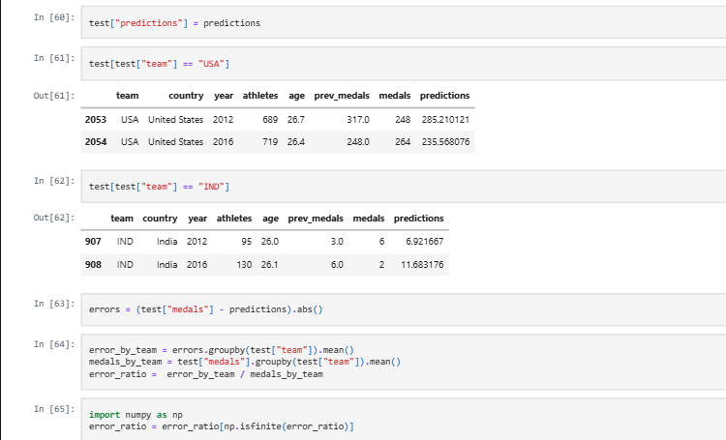
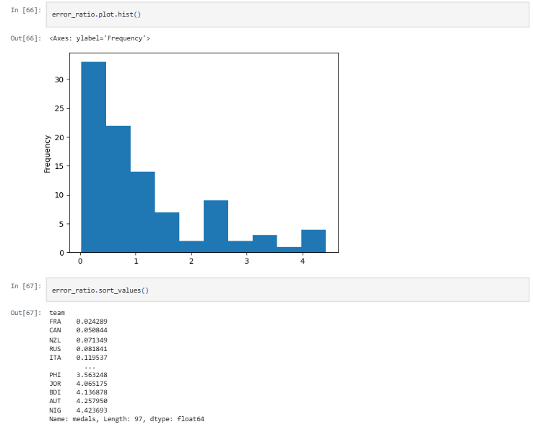
Result
The model successfully predicts medal counts with decent accuracy.
The result is visualized as shown below:

Slide 8
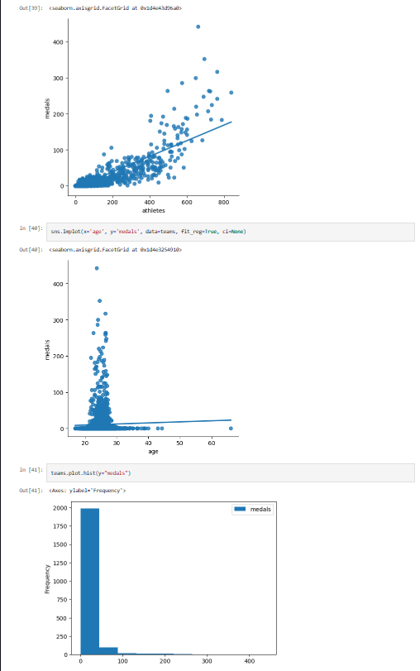

Slide 9
Conclusion
The project demonstrates that historical athlete and event data can be used effectively to predict national Olympic performance.
It provides a framework for federations to analyze and optimize their sports strategies.
Further tuning and more sophisticated models (e.g., ensemble methods) may improve accuracy.

Slide 10
Future scope
Integration of deep learning models and neural networks for complex pattern recognition.
Use of real-time performance data (e.g., athlete rankings, recent wins) to improve prediction.
Extension to individual athlete-level medal predictions.
Deployment as a dashboard or app for sports analysts and federations.

Slide 11
References
Kaggle Olympic History Dataset
Python (pandas, scikit-learn documentation)
Jupyter Notebooks
IOC Official Website for historical data validation
GitHub Link: https://github.com/uddipbisht/AI-ML-1-Project.git

Slide 12
Thank you

